Slide 1
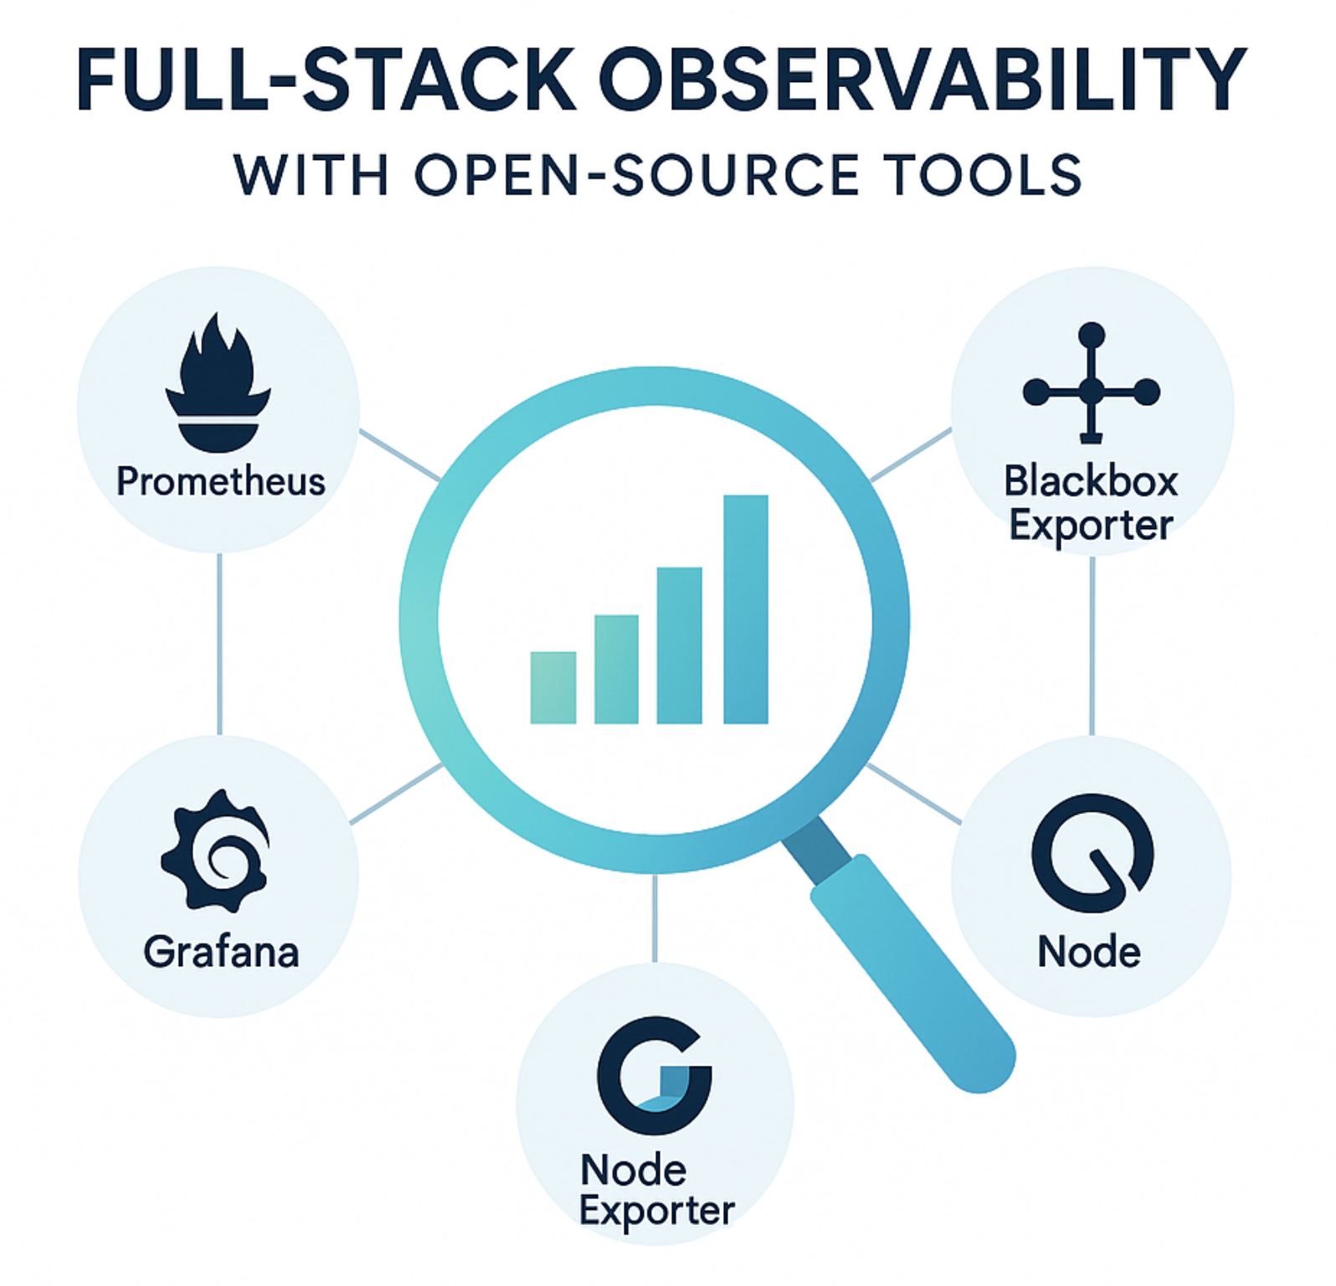
Full stack Observability with OpenSource Tools

Slide 2
Agenda
Project Overview & Goals
Architecture Diagram & Integrated Tools
One-Click Deployment- GitHub & Helm
Key Benefits
Helm Structure
Roadmap & Next Steps

Slide 3
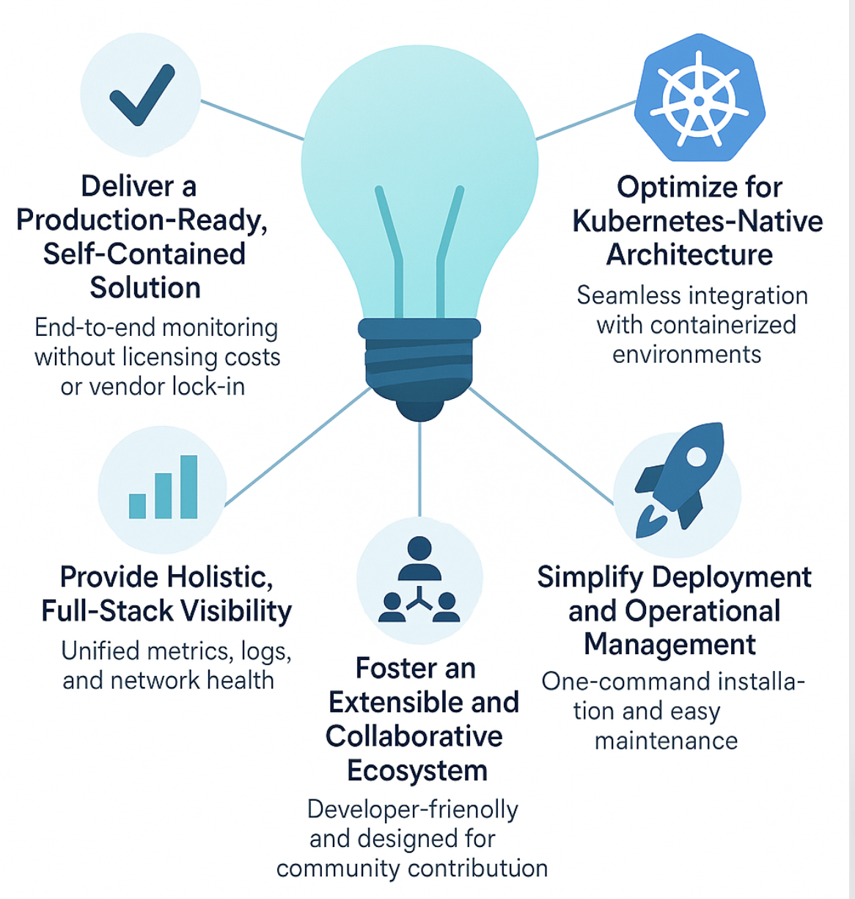
Project Overview & Goals
Our primary objective with this initiative is to develop an integrated, enterprise-grade observability platform. By consolidating industry-leading open-source technologies, we are creating a solution that simplifies monitoring and provides immediate, actionable insights across our entire technology landscape, from infrastructure to application performance.

Slide 4
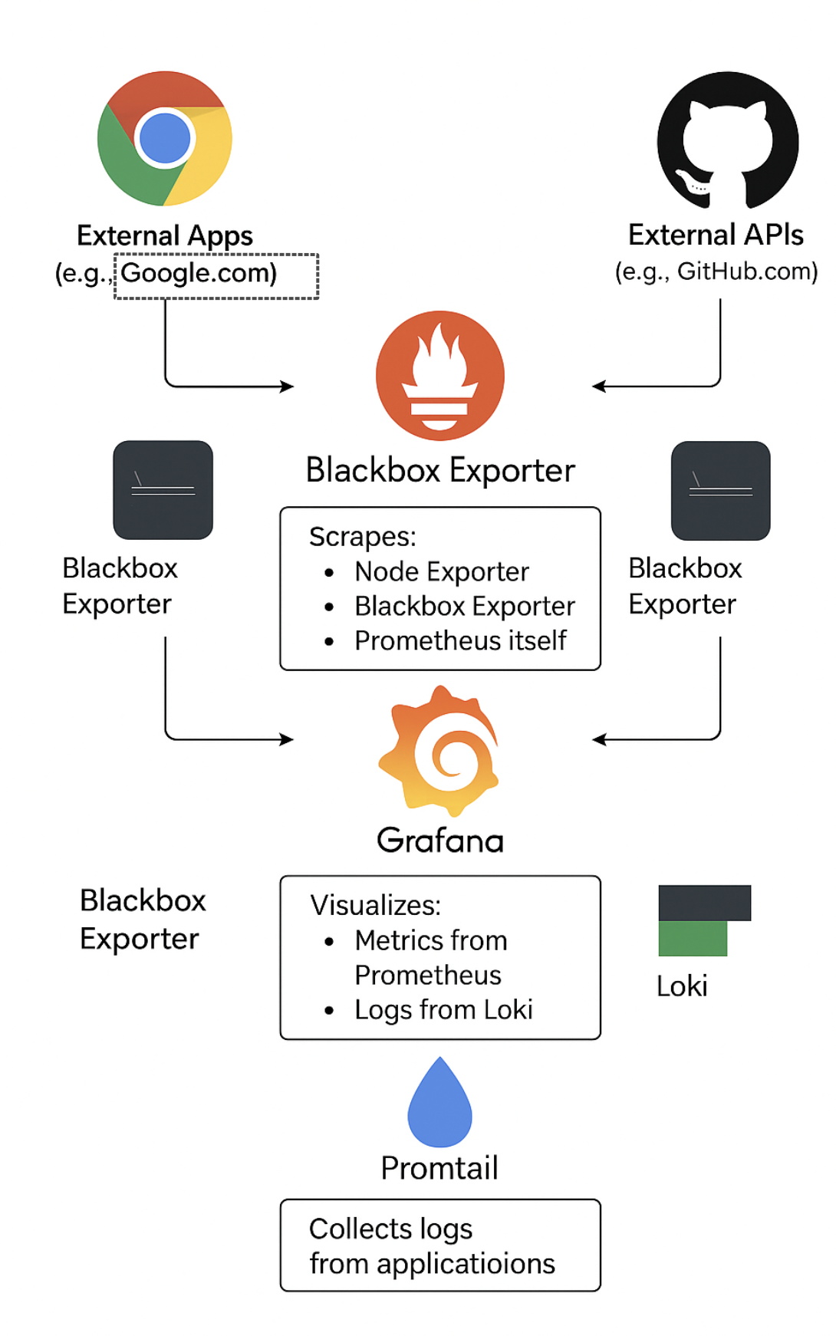
Architecture Diagram & Integrated Tools

Slide 5
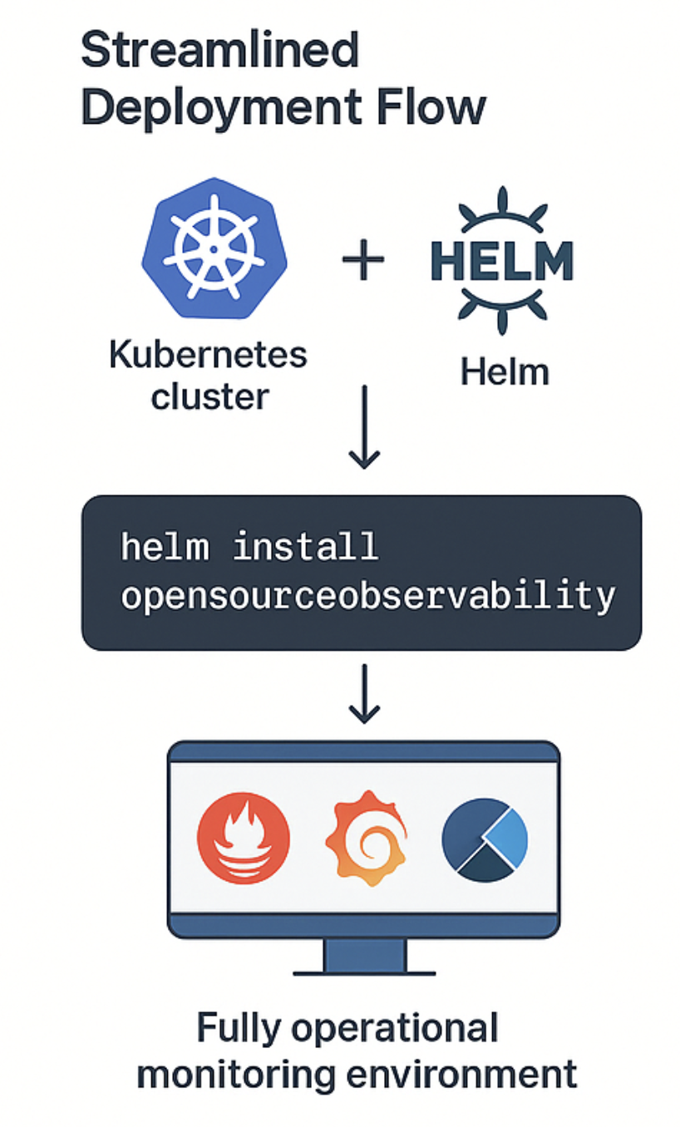
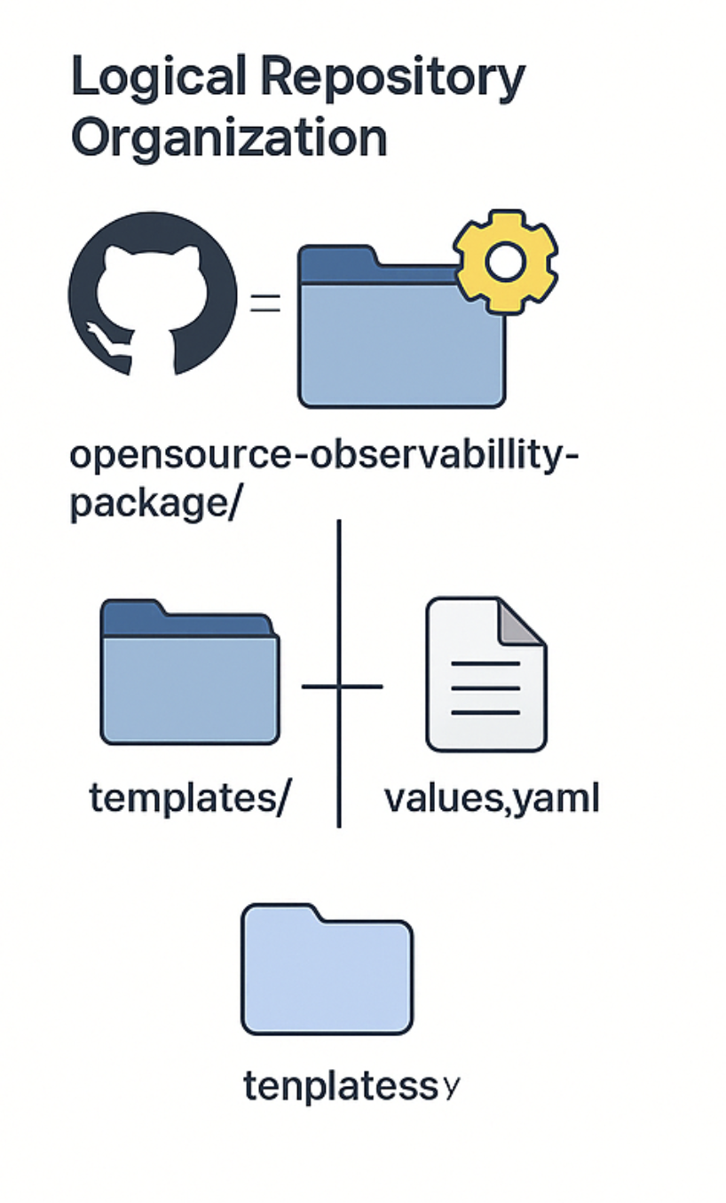
One-Click Deployment- GitHub & Helm
We have focused on two critical areas: a highly simplified deployment process and a clean, logical code structure. This approach minimizes setup time and makes the project transparent and easy for our teams to contribute to.

Slide 6
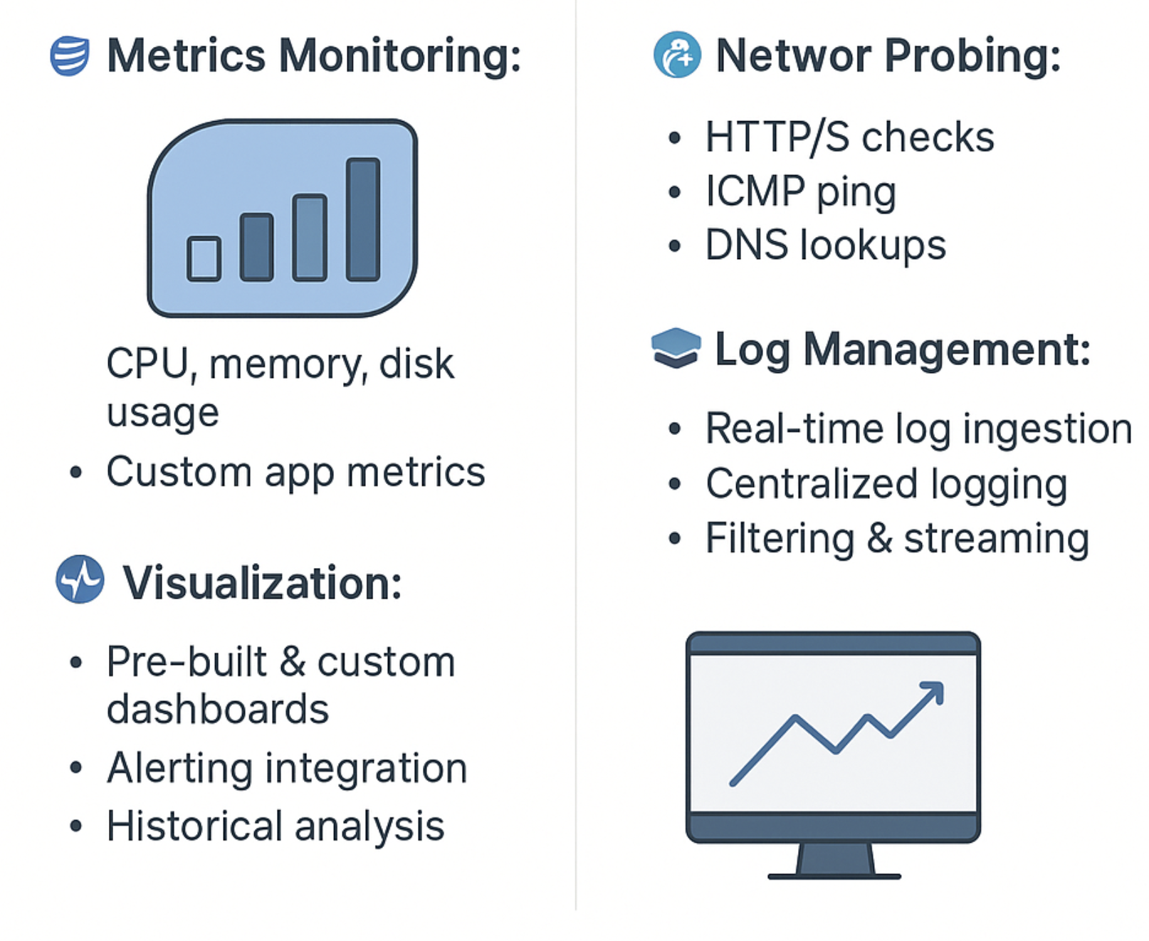
Key Benefits
This platform would deliver a comprehensive suite of monitoring capabilities, providing deep visibility across the entire technology stack which will have
Metrics Monitoring
Network Visibility
Log Management
Visualization & Alerting

Slide 7
Helm Structure
helm-kube-observability-stack/
├── charts/ # (Optional) Subcharts if needed
├── templates/ # Contains all Kubernetes manifest templates
│ ├── grafana-deployment.yaml # Deploys Grafana Pod
│ ├── grafana-service.yaml # Exposes Grafana service
│ ├── loki-deployment.yaml # Loki for log aggregation
│ ├── loki-service.yaml
│ ├── node-exporter-daemonset.yaml # Node-level metrics collection
│ ├── node-exporter-service.yaml
│ ├── prometheus-deployment.yaml # Prometheus core service
│ ├── prometheus-service.yaml
│ ├── prometheus-config.yaml # Prometheus scrape config
│ ├── promtail-deployment.yaml # Promtail for log shipping
│ ├── promtail-service.yaml
│ ├── promtail-config.yaml
│ ├── blackbox-exporter-deployment.yaml # For probing HTTP, ICMP, DNS, etc.
│ ├── blackbox-exporter-service.yaml
│ ├── blackbox-exporter-config.yaml
│ ├── namespace.yaml # Creates a dedicated namespace
│ ├── ingress.yaml # Ingress for UI access
│ ├── NOTES.txt # Helm notes shown after install
├── values.yaml # User-configurable settings for all components
├── Chart.yaml # Chart metadata (name, version, etc.)
This Helm chart bundles all observability components into a single, easy-to-deploy package. Here is the folder structure and a summary of its key files

Slide 8
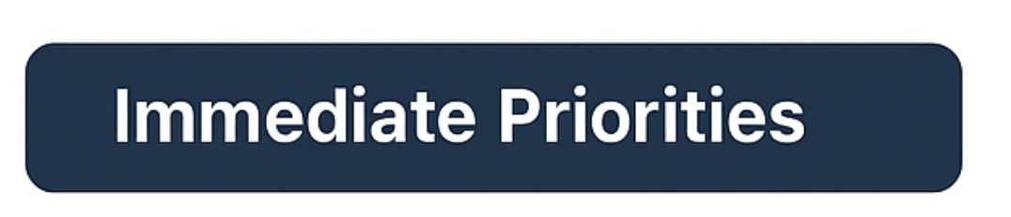

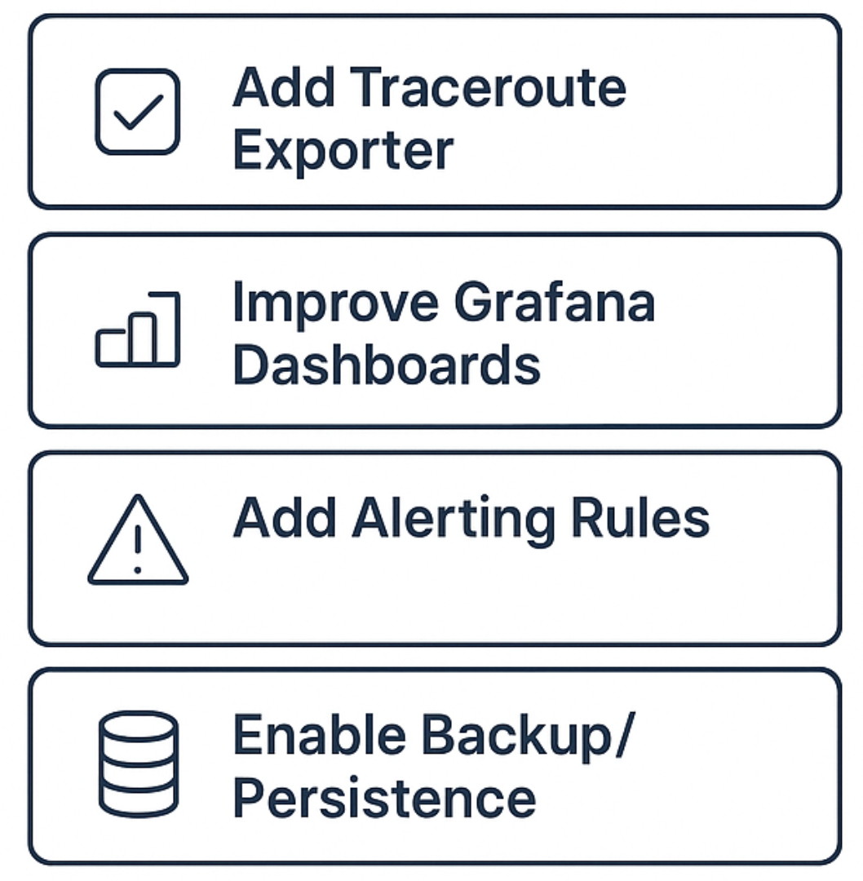
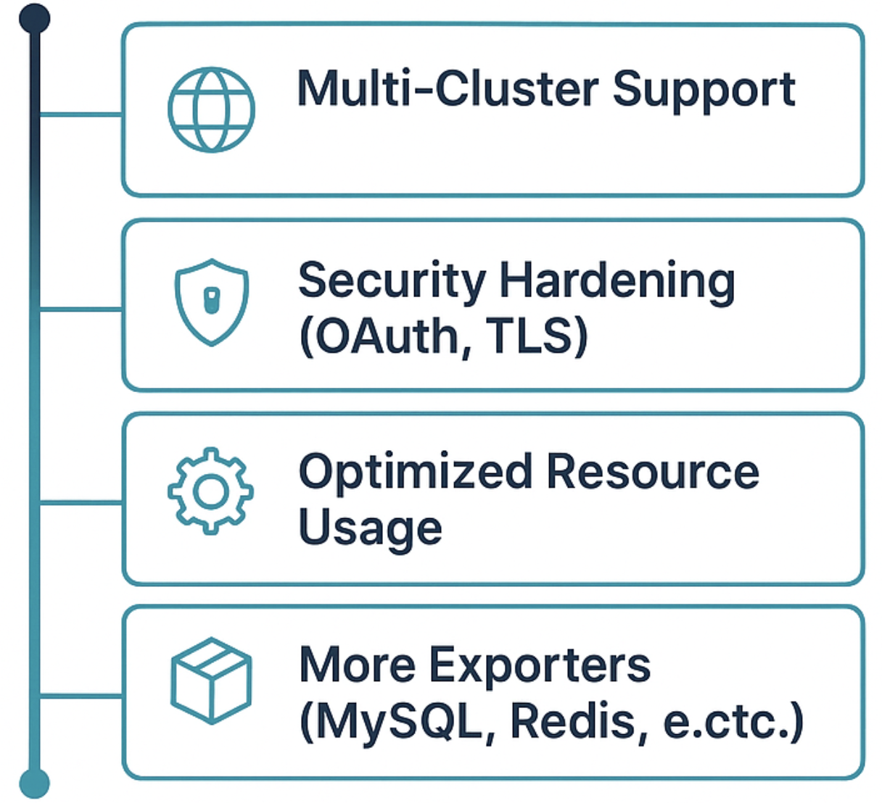
Roadmap & Next Steps
Open-source tools are generally good and budget-friendly way to start. But each tool by itself has some limitations. To make this a proper solution, we must plan for these limitations.
So, in the next phase of the project, our plan is to add some other tools. This will help us cover the more advanced monitoring requirements and make sure we have a complete solution.

Slide 9
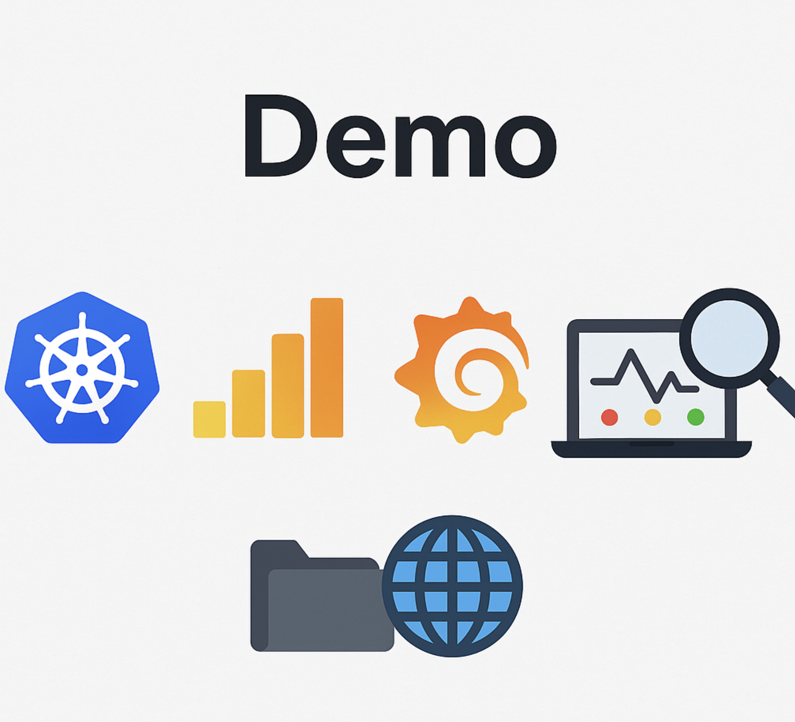

Slide 10
Questions
& Inputs

Slide 11
Thank you

